Slide 1


CUSTOMER DATA ANALYSIS AND PREDICTIVE MODELING FOR TERM DEPOSIT
SUBSCRIPTIONS AT A PORTUGUESE BANK
Presented by: Prashant Bisht

Slide 2


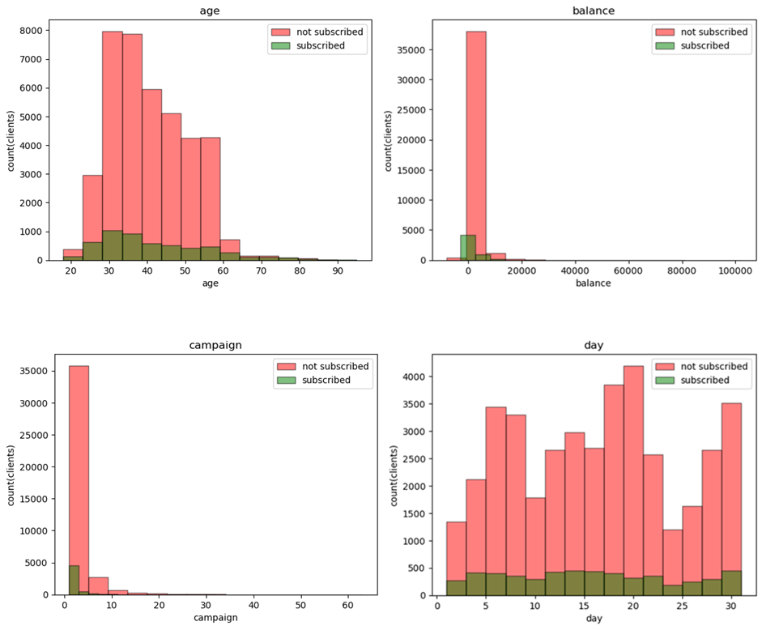


Analysis of numerical features
The youngest client is 18 years old and the oldest one is 95 years old.
90% of clients are less than 56.0 years old.
The minimum balance is -8019 euros and the maximum is 102127 euros.
50% of clients have less than 448.5 balance.
90% of clients have a balance of less than 3574 rupees.
The minimum number of contacts was performed one time and the maximum is 63 times. 50% of clients were contacted either one or two times.

Slide 3

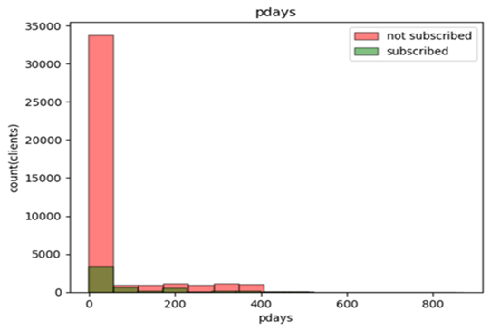
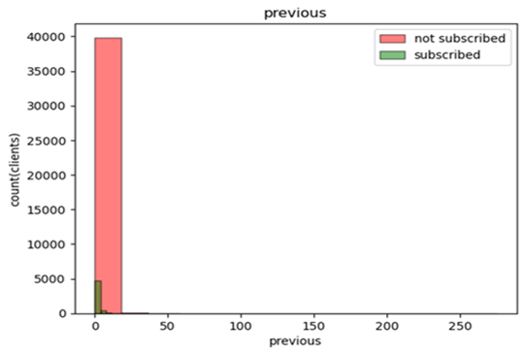
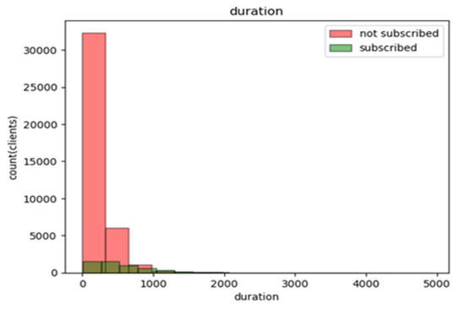


Analysis of numerical features
Among 45216 clients, 36956 no of clients were not contacted previously.
For some clients, 871 days has been passed since last contacted.
For 8260 clients, total no of 26255 contact were done before this campaign.
In the last contact, minimum duration was 0 sec and maximum was 4918 sec. However, for 90% of clients, it was less than 547.5 sec.

Slide 4

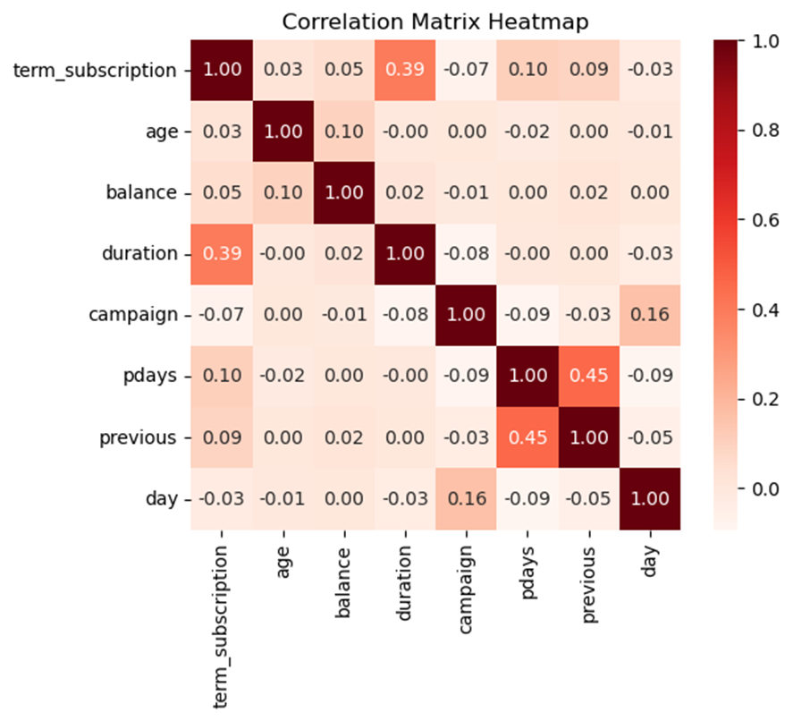


Correlation between Numerical features & target
Age and average annual balance are directly related to each other.
‘day’ and ‘campaign’ are directly related to each other.
‘day’ and ‘pdays’ are inversely related to each other.
‘duration’ and ‘campaign’ are inversely related to each other.
‘campaign’ and ‘pdays’ are inversely related to each other.
‘pdays’ and ‘previous’ are directly related to each other.
Likelihood of subscribing to a term deposit increases if:
Old adults with higher average annual balance are outreached.
After the first week of a month, the number of contacts performed during a campaign and for a client are increased.

Slide 5
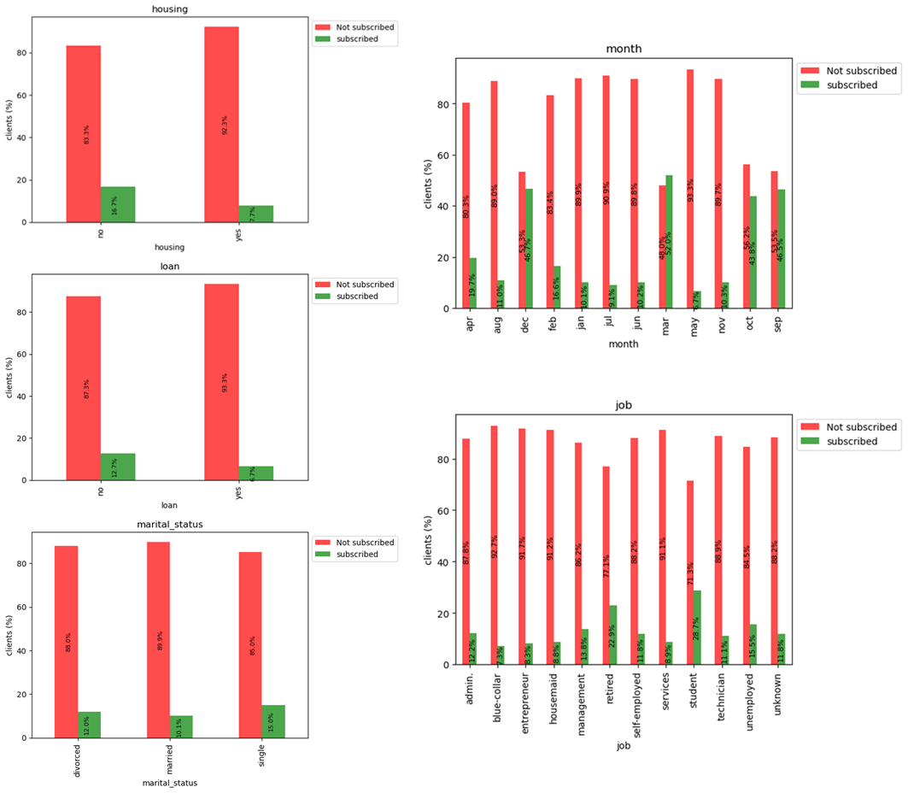

Categorical features vs Target
25130 clients have housing loans. Those without a housing loan subscribed to the term deposit more than those with a housing loan.
7244 clients have personal loans. Those without a personal loan subscribed to the term deposit more than those with a personal loan.
More than half of the clients are married. But single clients subscribed to the term deposit more than divorced clients.
Married clients are least interested to subscribe a term deposit.
In may, most of the contacts were happened. But it is the least successful month.
Very less clients are contacted in march, September, October and December. But these are the successful months in terms of term deposit subscription.
Most of the clients are technician,management and blue-collar. But Students & retired person are more interested for subscription.

Slide 6
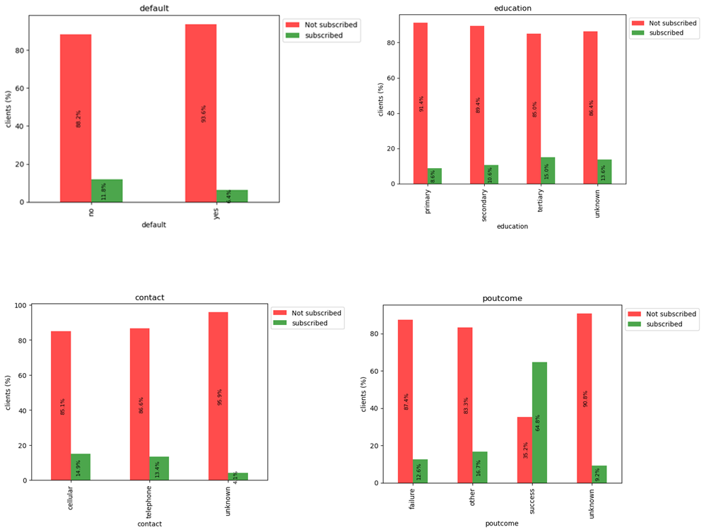


Categorical features vs Target
The clients whose credit is not in default are more interested for subscriptions.
More than half of the clients are secondary qualified.
Clients with higher education are more interested to subscribe a term deposit.
Subscriptions are not dependent on contact.
Previous successful campaigns are more effective for subscription a term deposit.

Slide 7
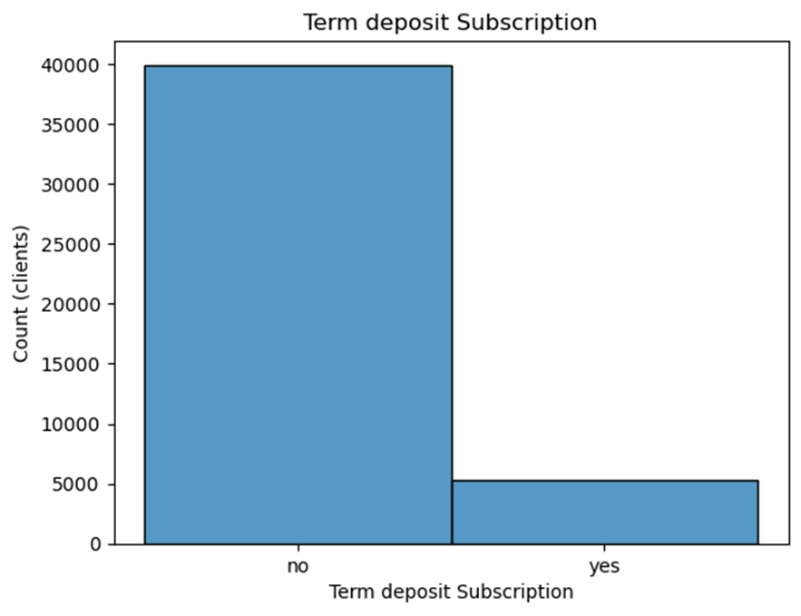



Target Analysis
11.71% of clients subscribed a term deposit.
So There is a data imbalance.

Slide 8



THANK
YOU

